Slide 1


ABDUR RAZZAK
ID: 222108108
Department of CSE
Uttara University

Slide 2

VERBAL
COMMUNICATION

Slide 3
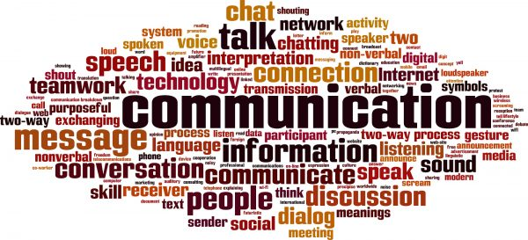
What is Communication?
Communication is a process of sending and receiving a message between two parties. Actually communication is the process of transferring information and understanding from one or more people to one or more people.
Sender
Message/
Information
Receiver

Slide 4

What is
Verbal Communication?
The Verbal Communication is a type of communication where in the message is transmitted through the spoken words. Here the sender gives words to his feelings, thoughts, ideas and opinions and expresses them in the form of speeches, discussions, presentations, and conversations.

Slide 5


Types of Verbal Communication-
1. Oral Communication
2. Written Communication

Slide 6

Oral Communication
What is oral communication?
Oral communication is process of expressing information or ideas by word of mouth.
Oral communication describes any type of interaction that makes use of spoken words.

Slide 7




Types of Oral Communication
Face to face communication
Public speech
Interview
Meetings

Slide 8

Advantages of
Oral Communication
More Powerful
More Suitable
Motivational
Immediate Feedback
Time Saving
Flexibility

Slide 9

Disadvantages of
Oral Communication
Create Misunderstanding
No Legal Validity
No Record
Lack of Secrecy
Late Decision
Defective

Slide 10

WRITTEN COMMUNICATION
What is Written Communication?
Written communication is performed through any written document. In other words any message exchanged between two or more person that make use of written word is called as written communication.
Written communication is the most important and the most effective of any mode of business communication.

Slide 11





Types of
Written Communication
Email
Letters
Notice
Reports

Slide 12

Advantages of
Written Communication
Effectiveness
Authoritative Document
Easily Understanding
Acceptability
Reduction of Risk
Permanent Record

Slide 13

Disadvantages of
Written Communication
Lack of Flexibility
Lack of Secrecy
Expensive
Lack of Direct Relations
Wastage of Time
Late Feedback

Slide 14





Importance of Verbal Communication
Informs
Clarifies
Correct
Feedback
Power of Influence

Slide 15
Conclusion -
Verbal communication is the use of words to share information with other people.
It can therefor include both spoken and written communication.
However, many people use the term to describe only spoken communication.
The verbal element of communication is all about the words that you choose, and how the how they are heard and interpreted.

Slide 16
thanks.

